Slide 1
Car accident severity
Name: Noor Kouli
IBM Data Science

Slide 2
Predicting Car Accident Severity in Seattle, Washington
Car accidents can categorized between how severe the collision was.
Predicting the severity code of a car accident can help signal the driver to drive more carefully, change his/her route or postpone an important meeting.
There are many variables highly correlated with the severity of a car accident such as weather conditions, speeding, driver fatigue and so on.

Slide 3
Data Preprocessing & Cleaning
Data consists of 146,059 rows and 38 features for vehicle collisions in Seattle, Washington from 2004 to present day.
34 features were dropped and only 4 were kept.
Weather, vehicle count and collision type were the features chosen to classify the severity code.
In addition, null and duplicate values were dropped leaving blank rows and blank columns.

Slide 4
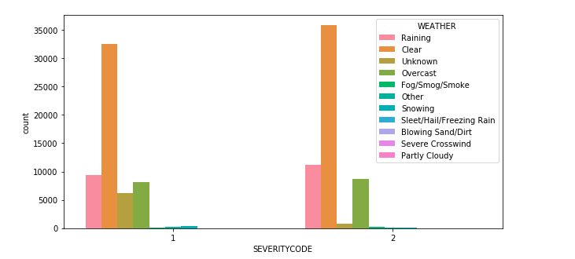
Data Visualization
More accidents in rainy weather led to a severe collision causing injury (SEVERITYCODE =2).
Most accidents occurred in clear weather conditions.
Not much correlation between weather and severity of car accidents.

Slide 5
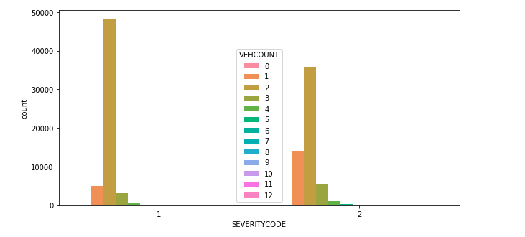
Data shows that most car accidents occur between 2 vehicles and lead to property damage (SEVERITYCODE=1).
Accidents involving 1 or 3 vehicles were more severe and likely caused injury (SEVERITYCODE=2).
There is negligible data on collisions between 7 to 12 vehicles.

Slide 6
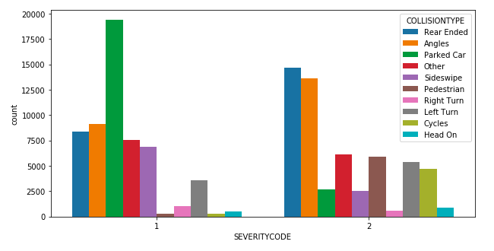
Good correlation between collision type and severity code.
There is sufficient data for each collision type to make a reliable comparison and predict future severity codes.
Most parked car accidents are under the severity code of ‘1’.
More rear ended, angled accidents and pedestrian accidents were recorded with a severity code of ‘2’.

Slide 7
Machine Learning
Three Machine learning models will be tested:
K Nearest Neighbor
Decision Tree
Linear Regression
Model evaluation tests:
Jaccard Score
F1-test
LogLoss

Slide 8
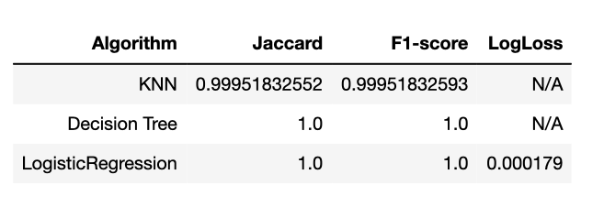
The results for the machine learning algorithms shown below appear to have very accurate predictions.

Slide 9
Conclusions
The results were very unexpected because all three models gave almost the same accuracy and predictions.
Features chosen may not have been the best to correlate with the severity code.
The data in the train and test sets were very similar because the data was encoded using get_dummies resulting in a simplified binary system.

Slide 10
Future Recommendations
Include more data on accidents in different weather conditions other than clear skies.
Include more data on accidents that involve more than 3 vehicles.
Analyze car accident data on a state with the highest car accident rate for better models.

